Slide 1

Data 2 John R Williams, MIT

Slide 2
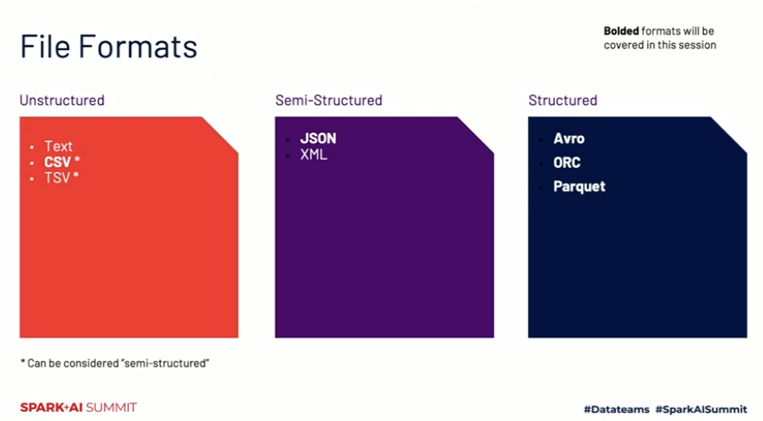
https://parquet.apache.org/docs/learning-resources/presentations/spark-summit-2020/

Slide 3
JSON Structure
[….] list/array eg [1, “two”, {“key”: “value”}
{…. } object / dictionary eg {“name”: “anne”}
{ “contacts” : [{”name” : “anne”}, {”name”: “fred”} ]
Object called contacts which is an array of objects
Alternatively
{ “contacts” : {”names” : [“anne”, “fred”]]}}

Slide 4

Data +AI+ Cloud
Data First Companies
Data Reduces Risk
Cloud
Scale and Stability
ML +Automation
Speed
Experiments
Learn Fast, Unlock Innovation

Slide 5

Data First Companies

Slide 6
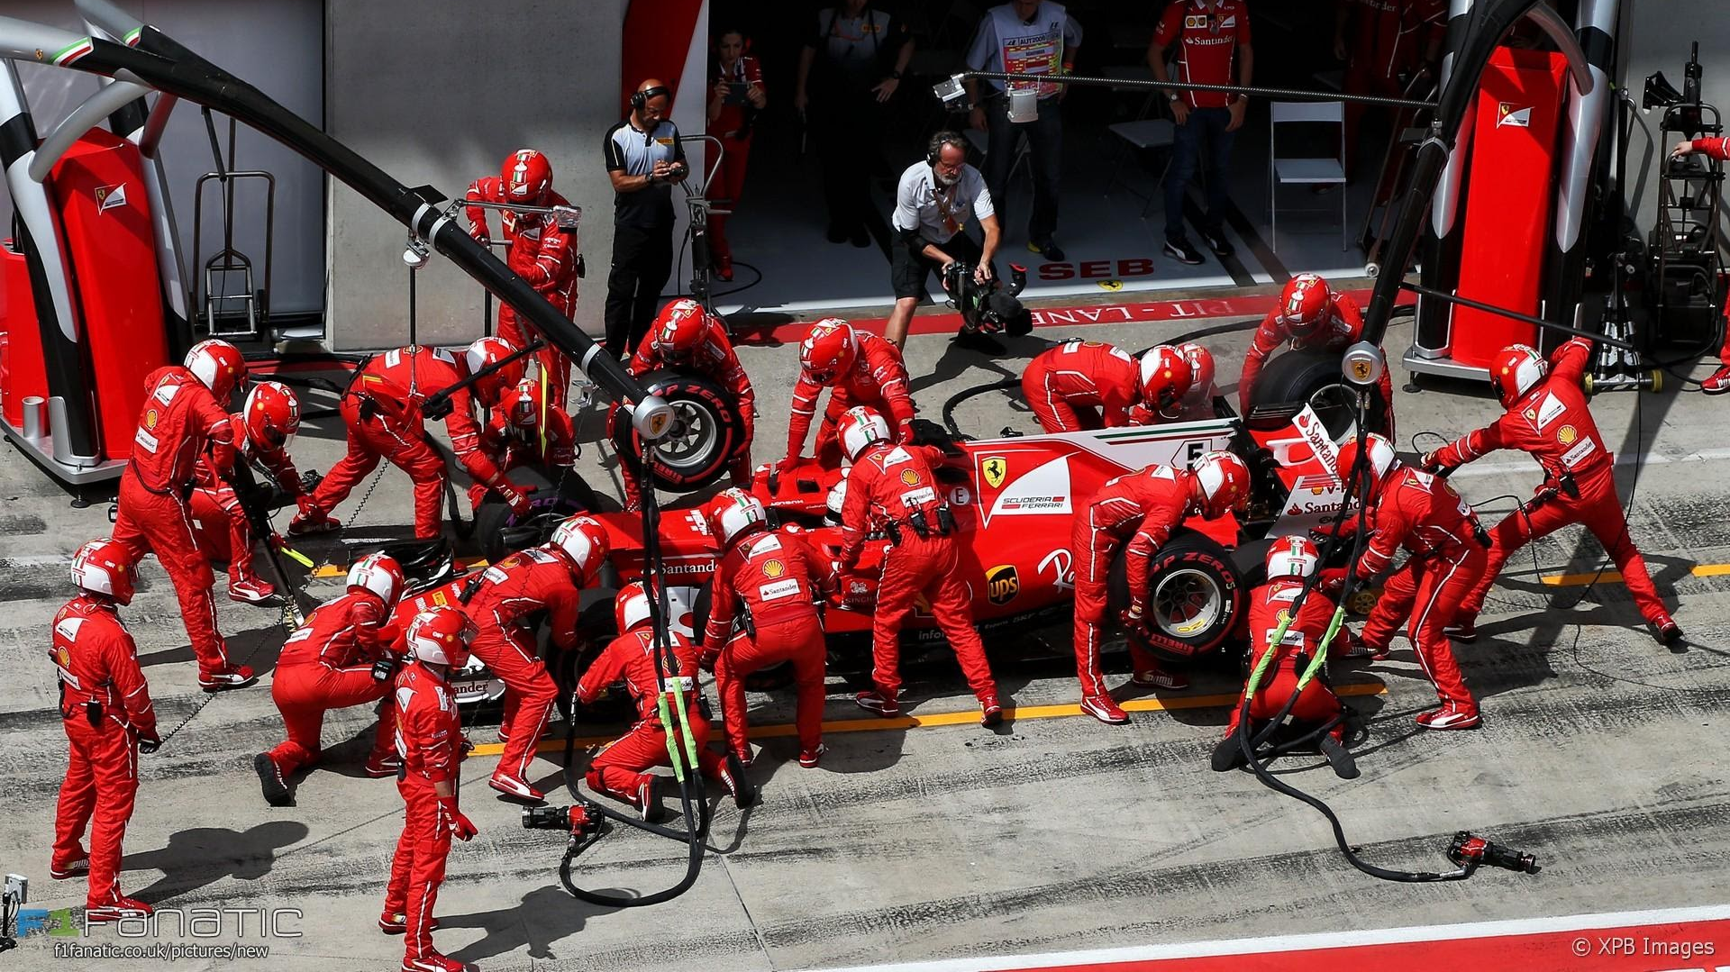
Driven by Data

Slide 7

Data Driven Decision Making

Slide 8
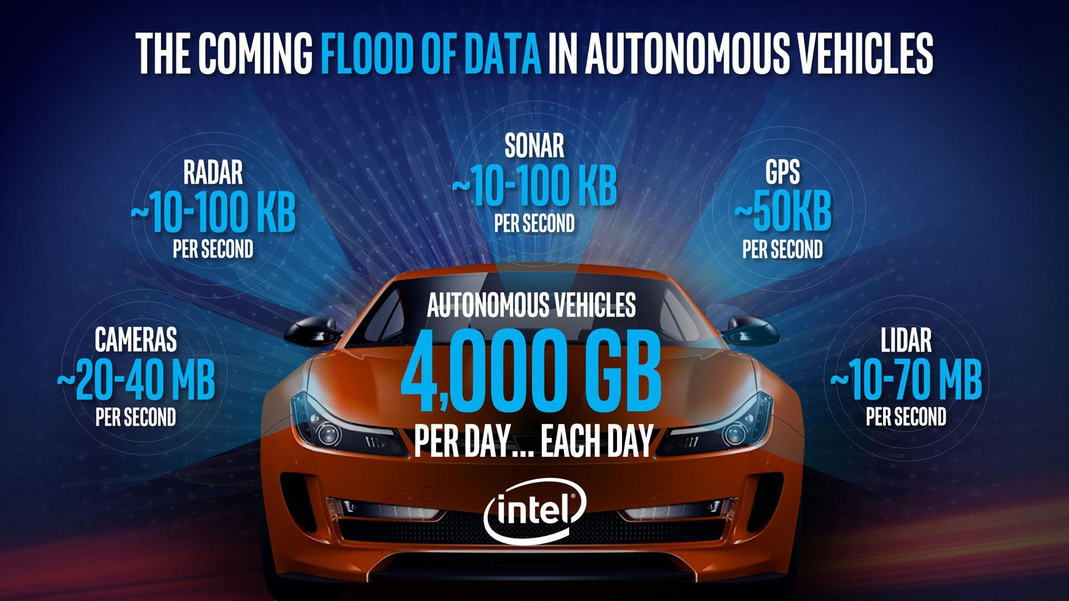

Slide 9
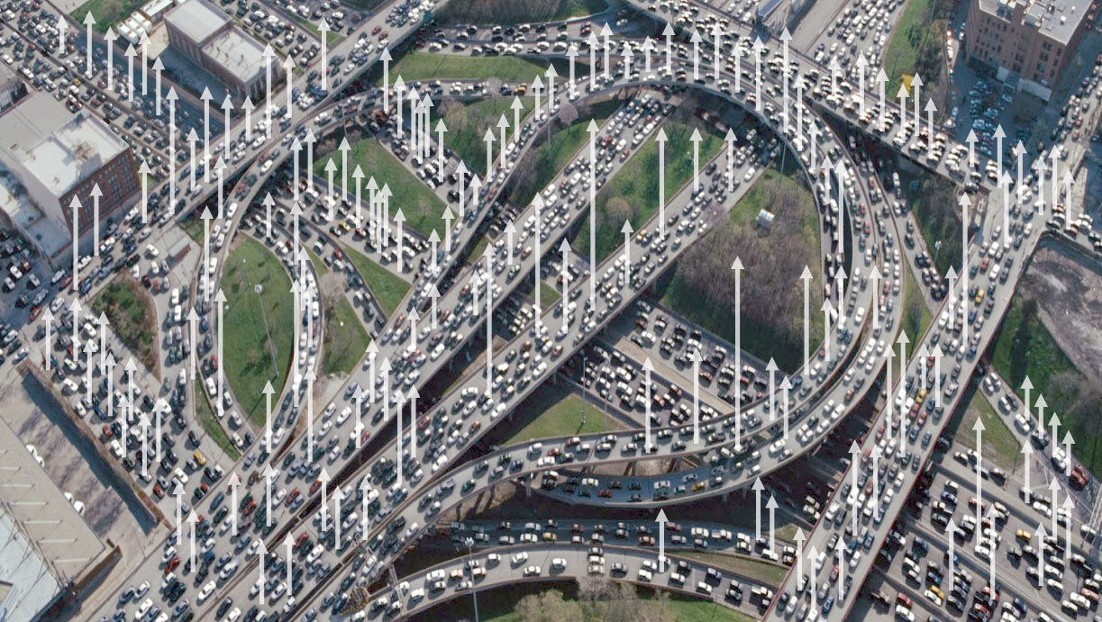
Data Explosion

Slide 10


Slide 11




DATA

Slide 12
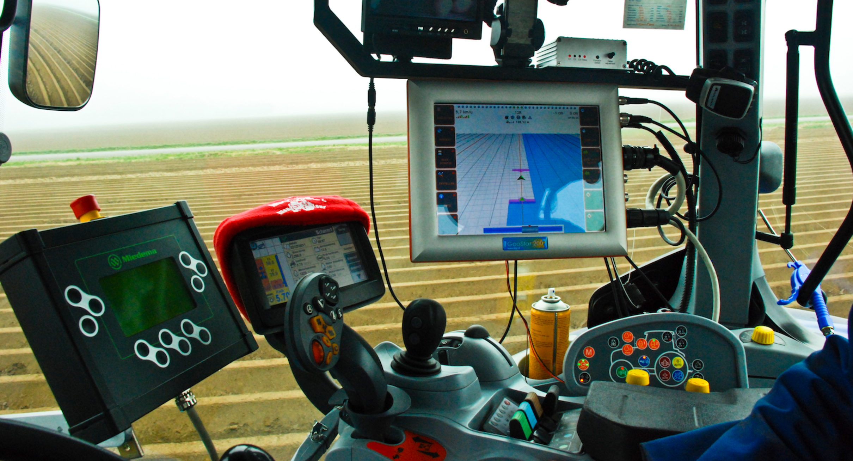

Slide 13
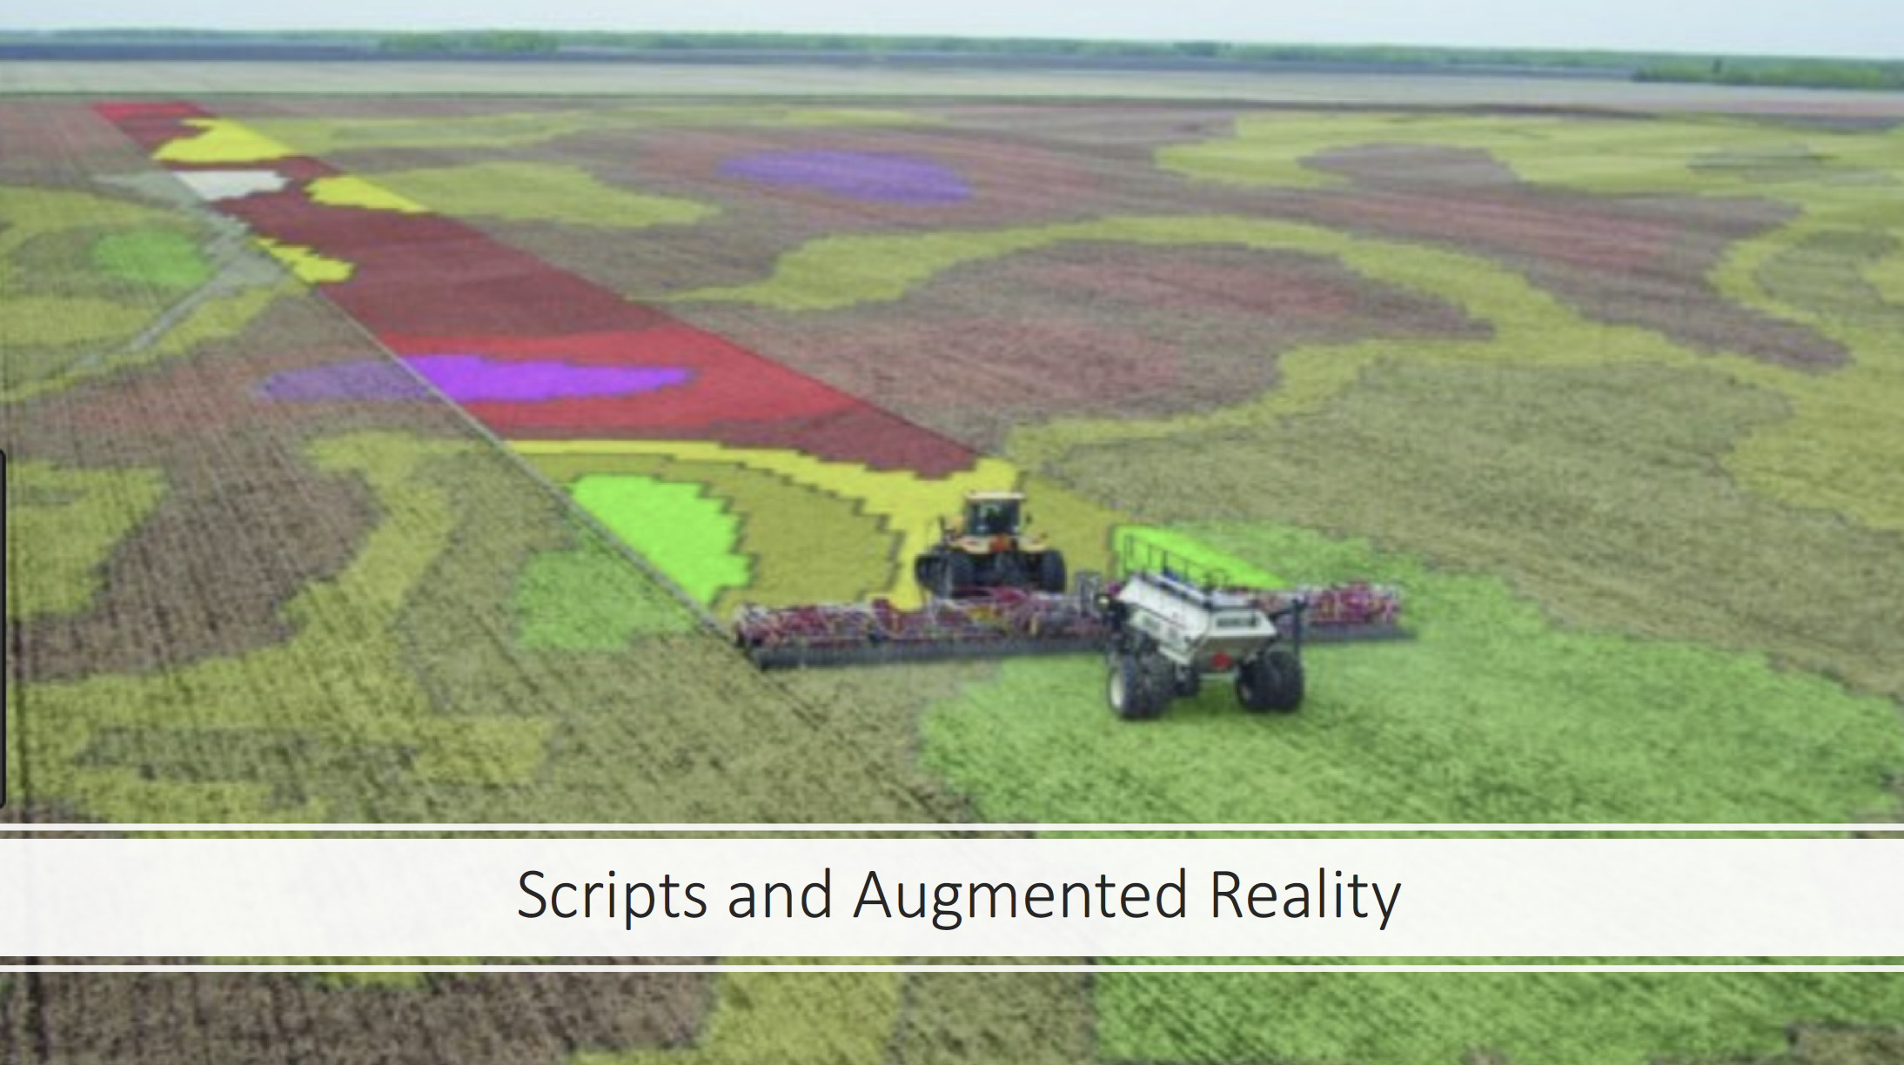

Slide 14
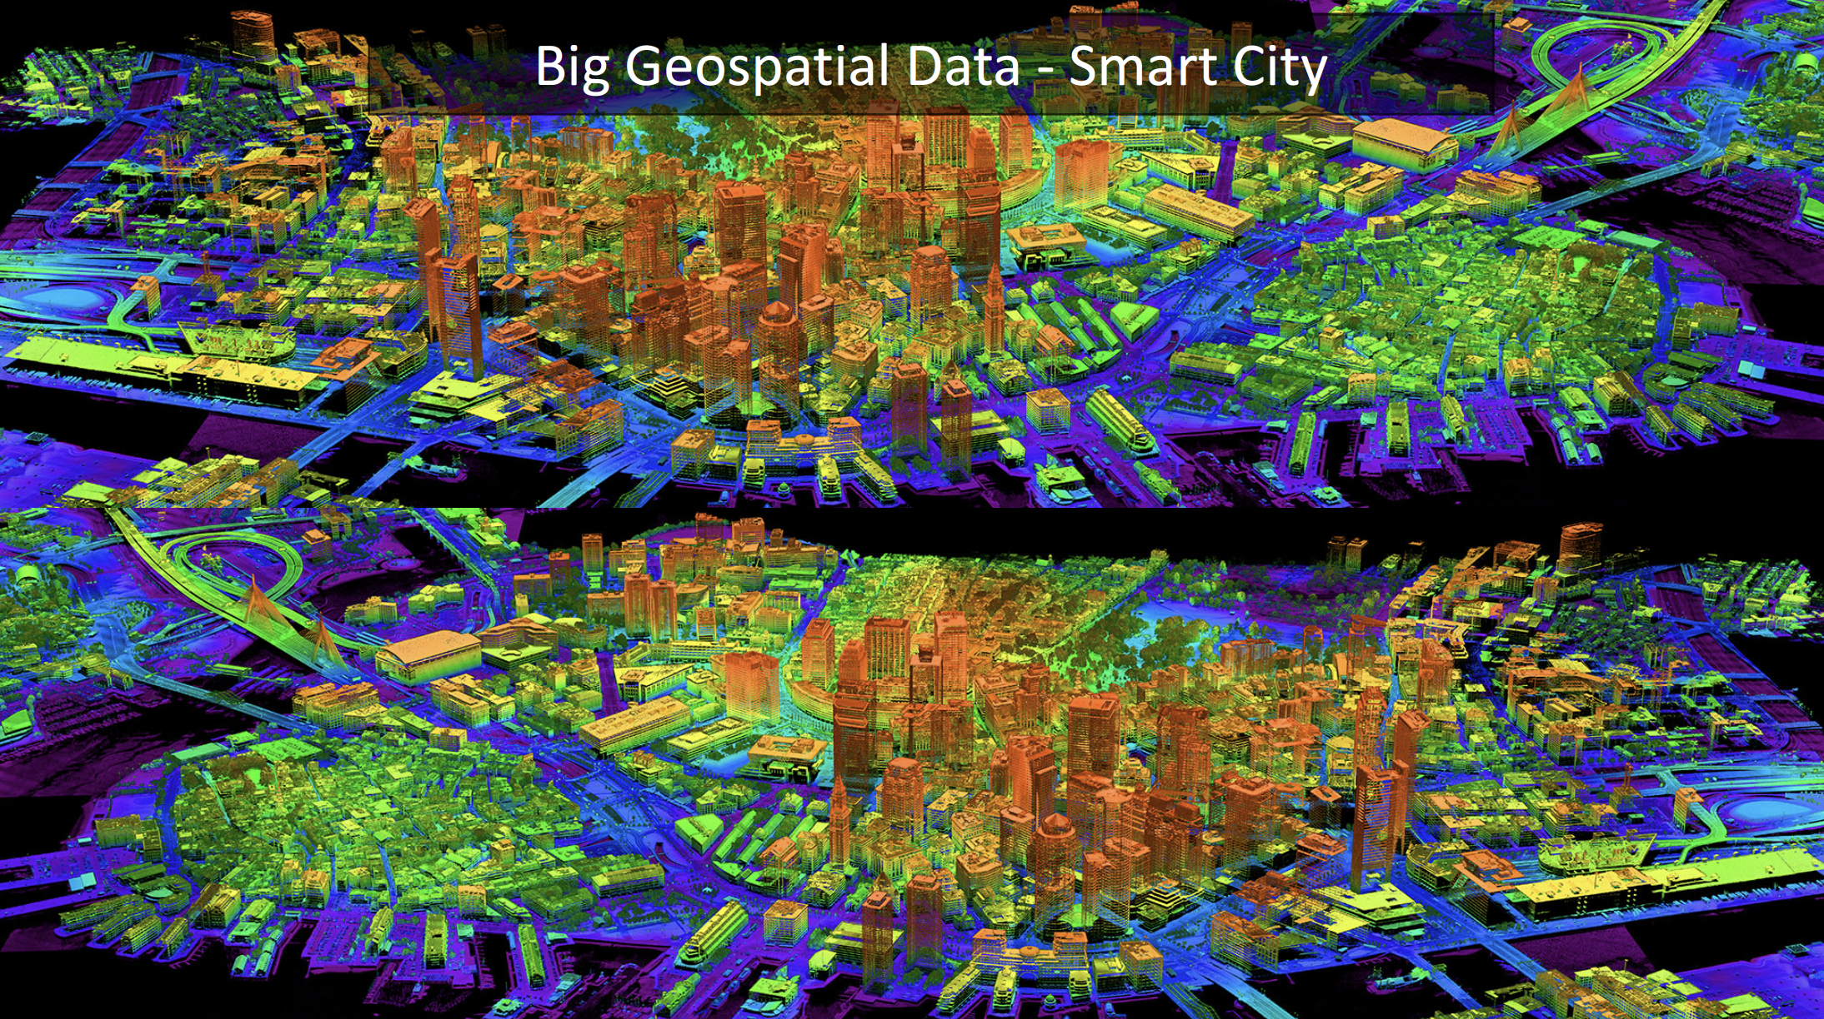

Slide 15

Coordination Platforms Uber’s Multi-Cloud Netflix Streaming Video AirBnB Real-Time Room Pricing

Slide 16










Business Intelligence Pipeline – Analytics and BI
BI Tools & Reports
Google BigQuery
Online Apps
Raw Data
Connectors
Google
Tableau
Power BI
Looker
Transform
GitHub

Slide 17

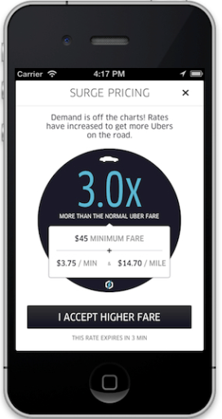
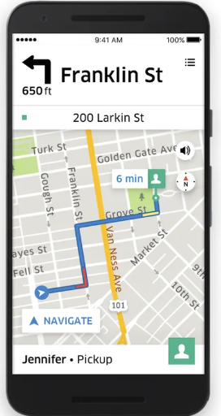






Business Operations ML Predictive Control Pipeline Example Surge Pricing
Customer
Data
Kinesis/Kafka Pub/sub
Elastic Search
And S3
AWS Redshift
Feature
Engineering
Surge
Pricing
Transform

Slide 18

ELT Pipeline Using BigQuery
BI Tools & Reports
Google Sheet
Connectors
BigQuery
Google
Tableau
Power BI
Looker
Transform
GitHub

Slide 19
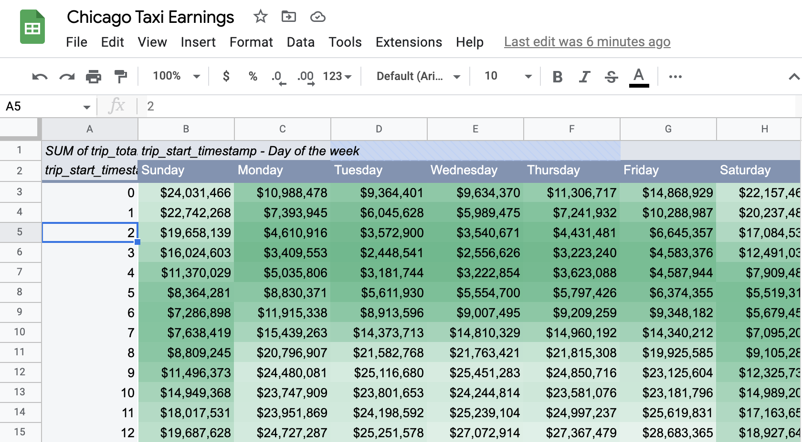
212 Million Rows

Slide 20

Six Stages of Data Pipeline Maturity (Chris Riccomini)
Stage 0
None
Stage 1
Batch
Stage 2
RealTime
Stage 3
Integration
Stage 4
Automation
Stage 5
Decentralization

Slide 21
Typical Cloud Architecture

Slide 22
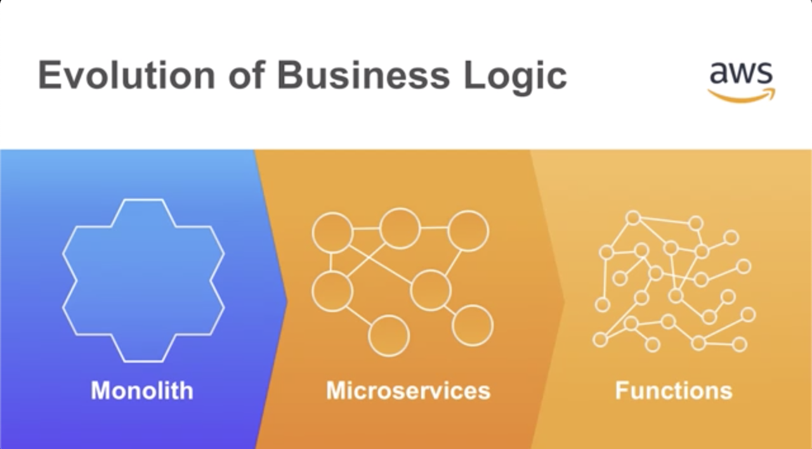

Slide 23
Education Transformation
https://johntango.github.io/#/teaching

Slide 24
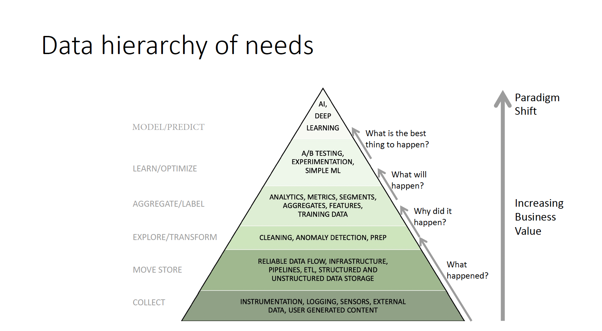

Slide 25
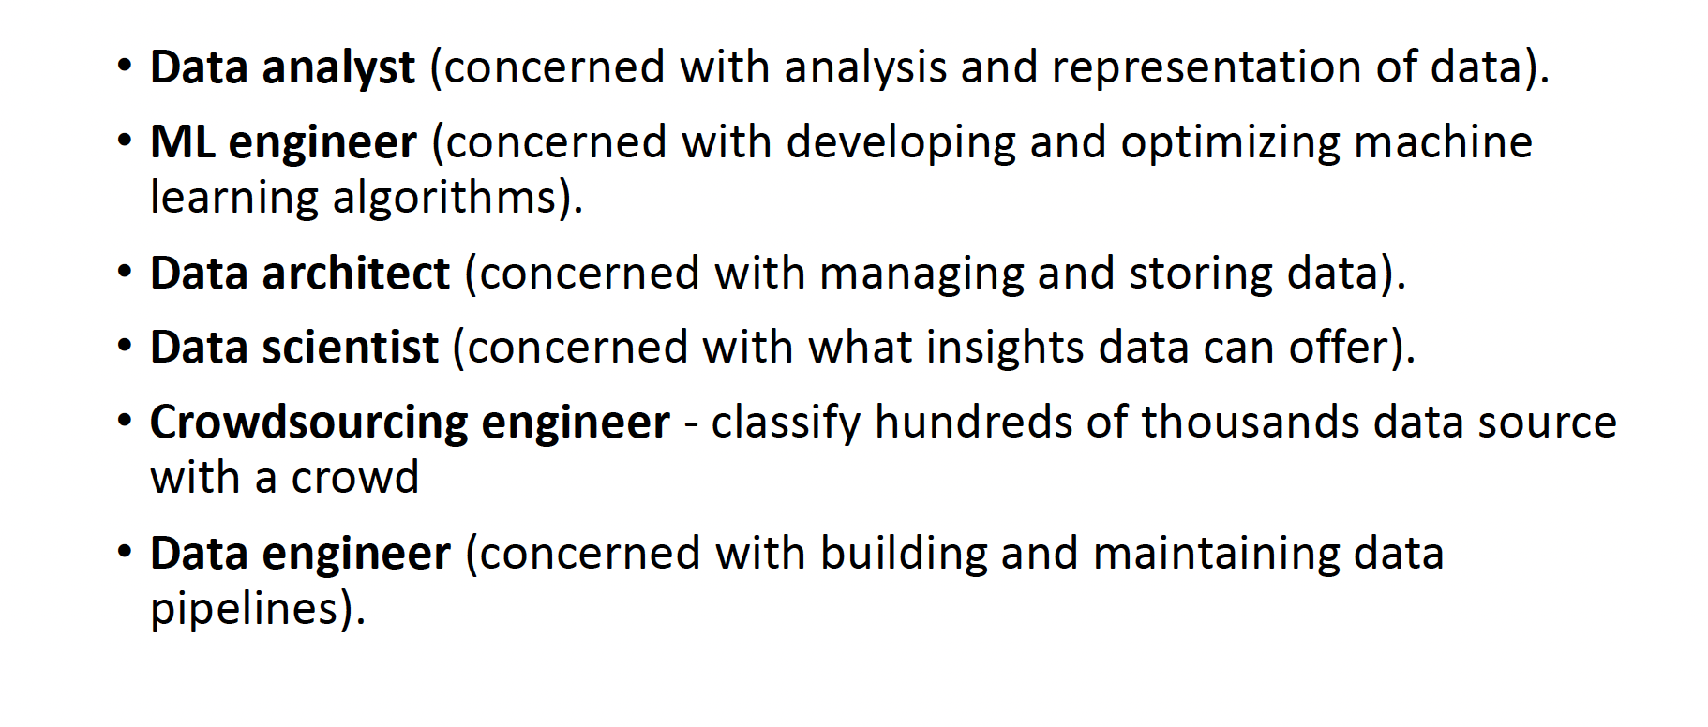
Job Titles

Slide 26
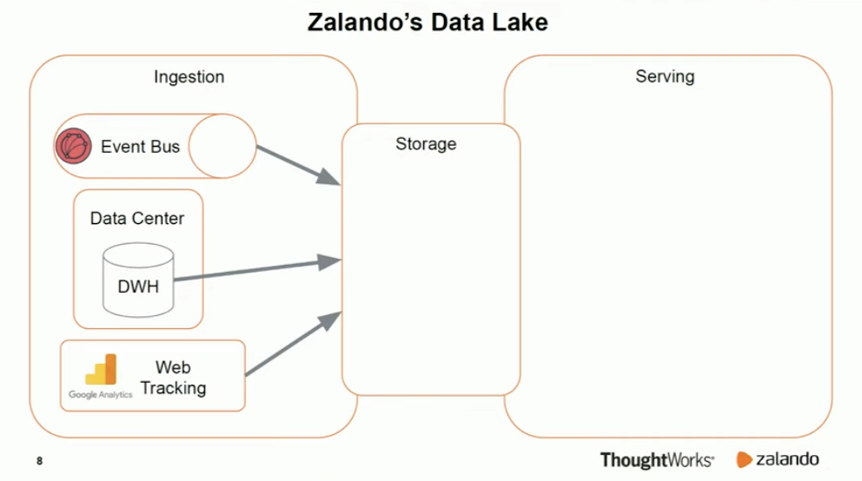
Data Lake Stage 1

Slide 27
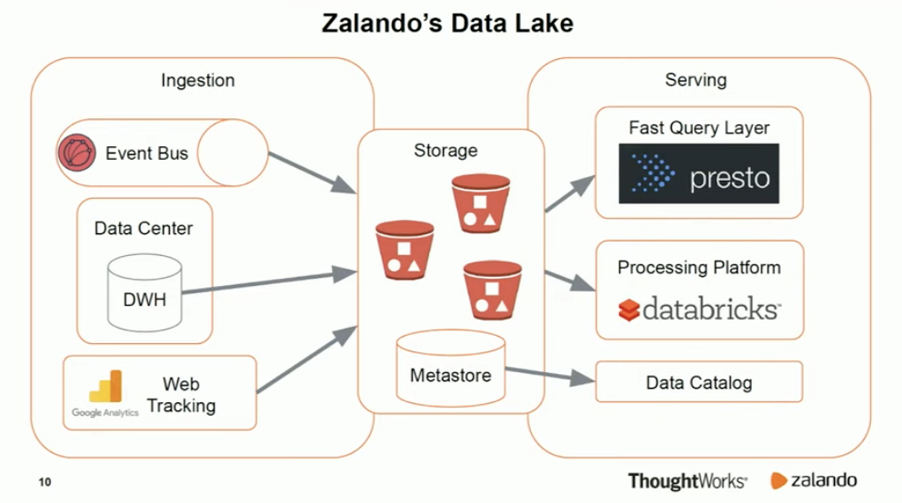
Data Lake Stage 1

Slide 28
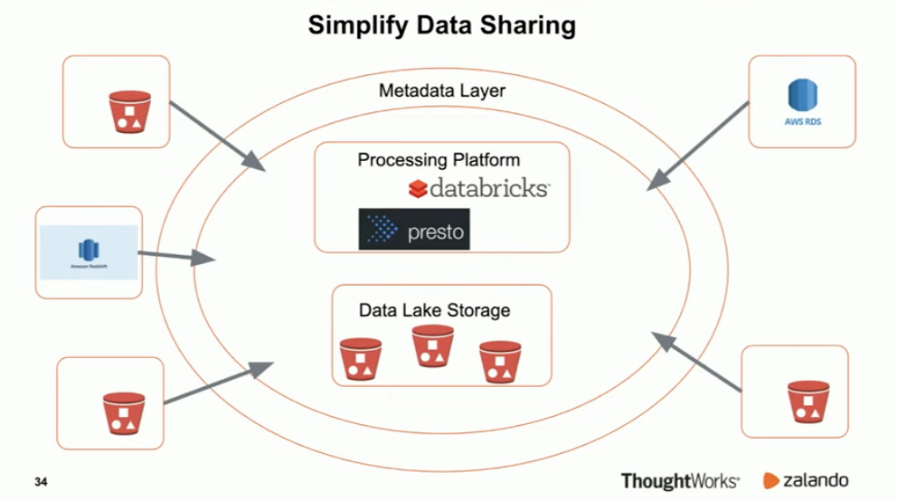
Simplify Data Sharing

Slide 29

Work from anywhere Remote Pool of Workers

Slide 30
The Cloud

Slide 31

AWS 2006

Slide 32
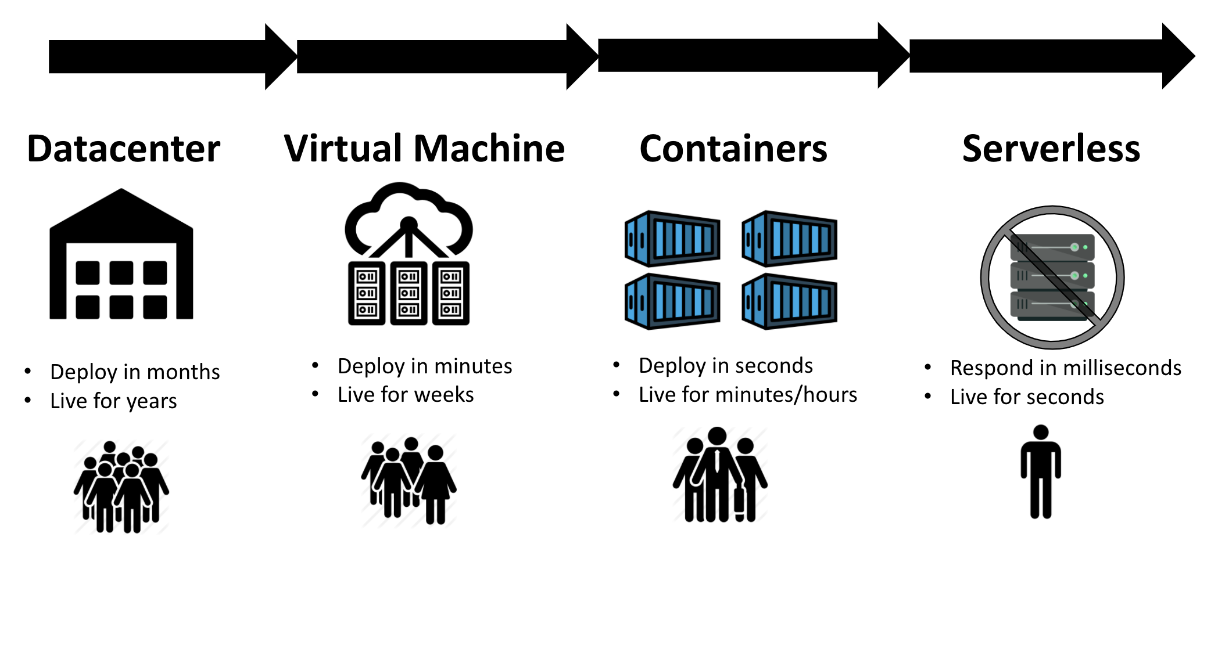

Slide 33

AWS today has over 200 Products including Ground Station Service https://www.youtube.com/watch?v=JIbIYCM48to

Slide 34


Slide 35
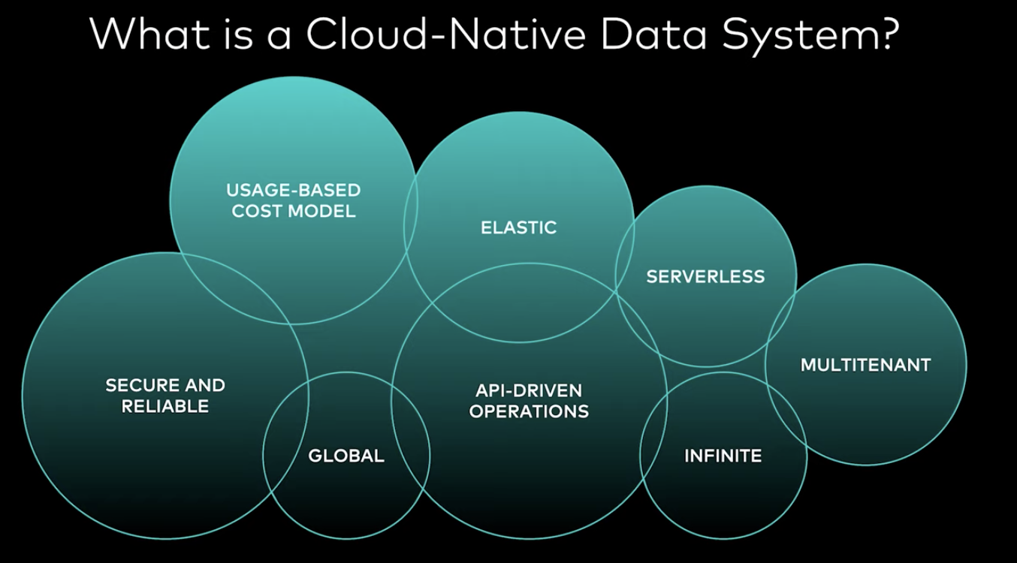

Slide 36
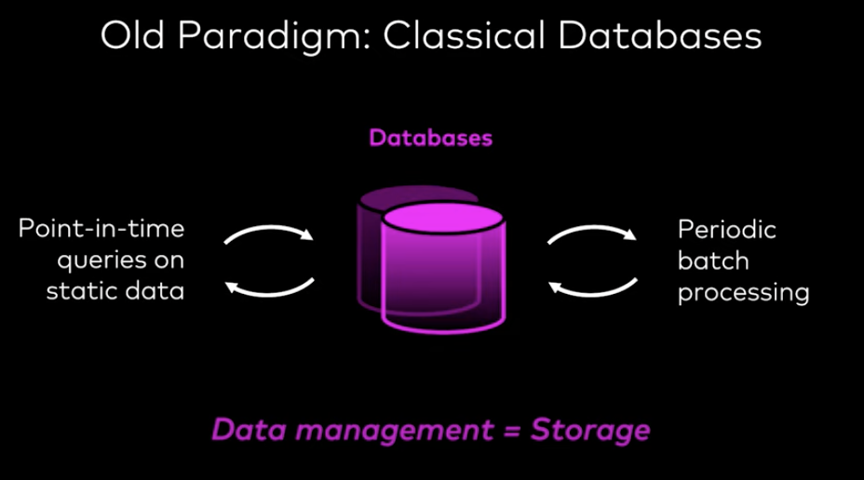

Slide 37
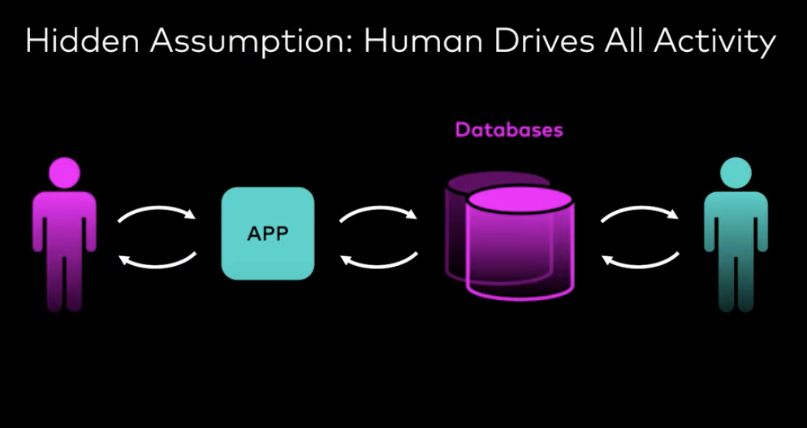
https://www.youtube.com/watch?v=nQmdoAVcGhA

Slide 38
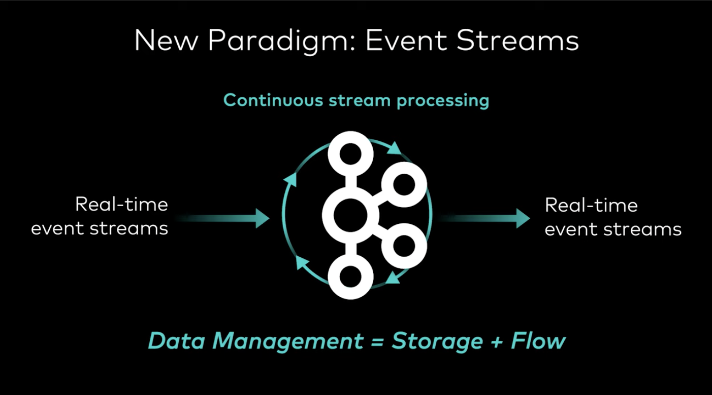

Slide 39
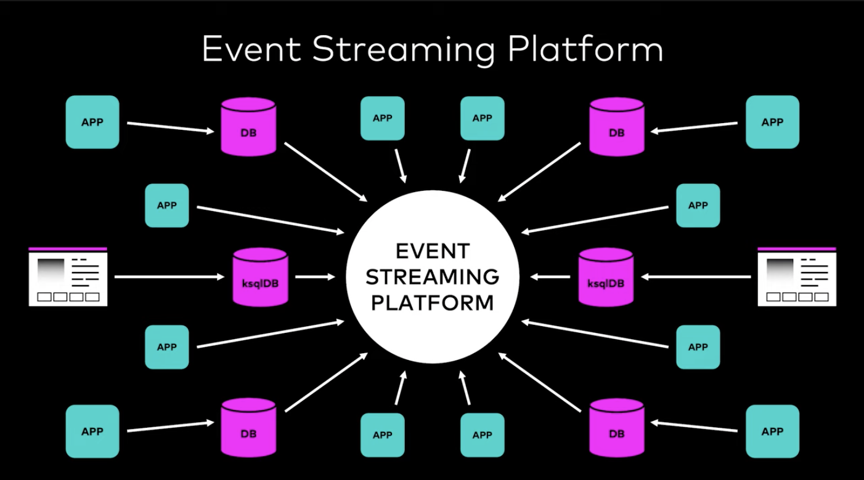

Slide 40


